Slide 1
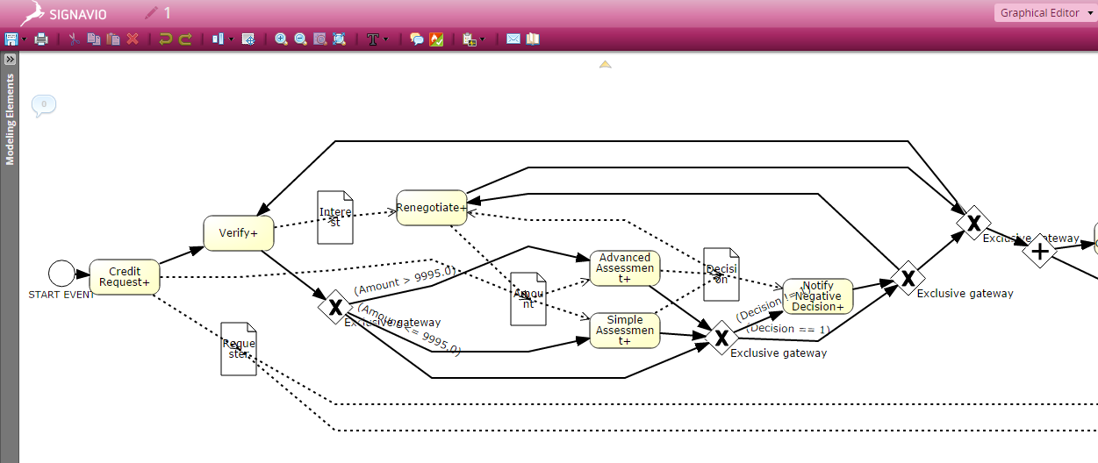
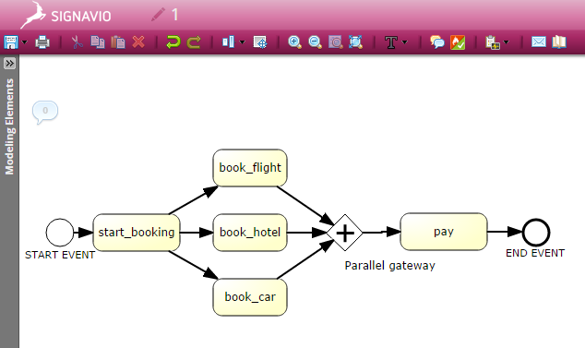
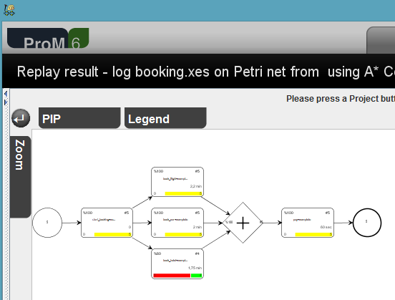
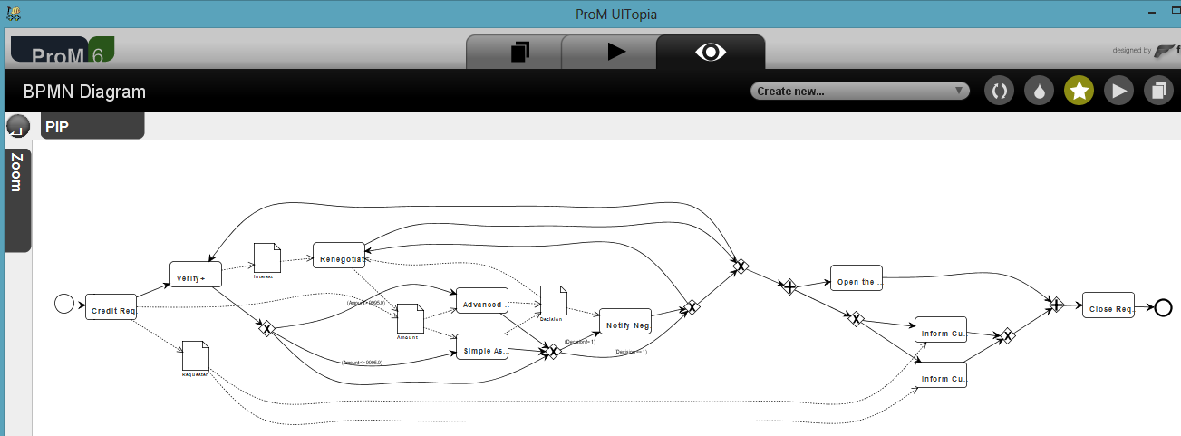
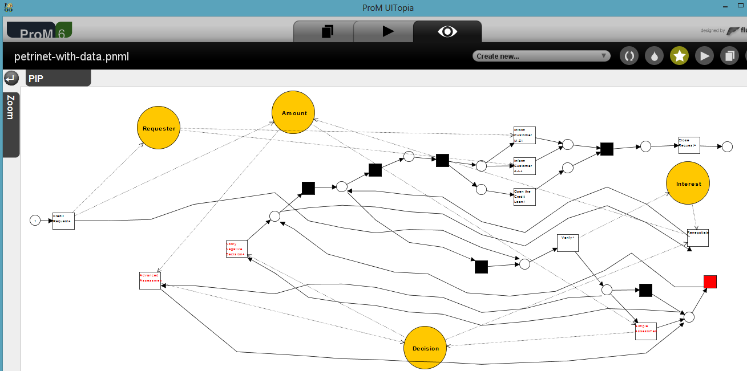
Discovering, Analyzing and Enhancing
BPMN Models Using ProM
ProM supports a basic set of BPMN modeling elements and constructions
Import and export of BPMN diagrams
BPMN models can be discovered by applying conversion algorithms
BPMN model can be analyzed and enhanced with additional conformance and performance information
Anna A. Kalenkova Massimiliano de Leoni Wil M.P. van der Aalst
September 10 2014 BPM 2014

